Slide 1
EXAM CENTER ASSIGNMENT
TEAM MEMBERS
Koduri Bhavitha
Sai bhargavi Yaramuddaiah Gari Nalamala
Byalla Sunitha
Swarachita Acharya
Sowjanya K N

Slide 2
Introduction
It assigns exam centers to candidates based on exam id and candidate id.
These informations stored in text files.
Exam center allocation is the process of allocating places for the candidate to write the exam.

Slide 3
Day 1
Received the project document and spent time understanding the functional and nonfunctional requirement of our project.
Discussed over the working of the program by deciding which data structure to use and the functions we will need to make.
Divided tasks among team members and started working on them.
Created the RTM document and updated progress in it.
Started working on the SRS document file for the project.
Created input files for our application viz. examcentres.txt, candidate1.txt, candidate2.txt.

Slide 4
Day 2
Discussed about the current progress of the application and jotted down changes.
Started working on the DFD level 0 and level 1 diagram.
Spent time analyzing the working of our program and updating the flow.
Next, created the final flow diagram document.
Finally, created the pseudocode file which has the basic working of the application in layman terms for easy understanding.

Slide 5
Day 3
Started the coding part for the application.
Finally decided to use the data structure linked list to implement the program.
Created structures for the exam centers data and the candidates data.
Finalized the functions and started creating them.
Made functions that conform to the standard coding guidelines.
Adhered to use dynamic memory allocation and multithreading concepts.

Slide 6
Day 4
Started unit testing and Integration testing.
Used valgrind tool to detect memory leaks.
Finalizing the RTM, SRS doc, IT_UT file and uploading their PDF format on GitHub.
Uploading the final version of the code on GitHub and ensuring all files are present.

Slide 7
InsertExamData()
This function is the first function to be called when the application is called.
It parses the exam center data from the text file for details like exam centre number, examID, college and address.
It stores this data in a linked list "struct exam center" ready for further processing.

Slide 8
InsertCandidateData()
This function is used to insert candidate data while parsing it for the different fields.
It checks each entry for a valid condition and then stores this data in a linked list "struct candidate“.
We have used a mutex lock to lock the matched exam center until it is assigned to candidates giving that particular exam.
We have used file handling to store the invalid entries in a file called "invalidcandidates.txt“.

Slide 9
WriteToFile()
This function is used to assign the candidates their exam hall and save the file.
It checks the values of the linked lists, which store only valid entries and then allocates the students their exam hall.
We create a file for each exam hall that saves the candidate details of that exam center in the particular file.
This will help the exam admin controller and the exam candidates to search for their required information easily.

Slide 10
printHallTicket()
This function prints the hall ticket when the user enters the candidate ID.
If the candidate has entered the correct credentials then they will get their hall ticket which has all the details about their exam and exam center.
If not, then their details will be stored in the "invalid candidates.txt" file.

Slide 11
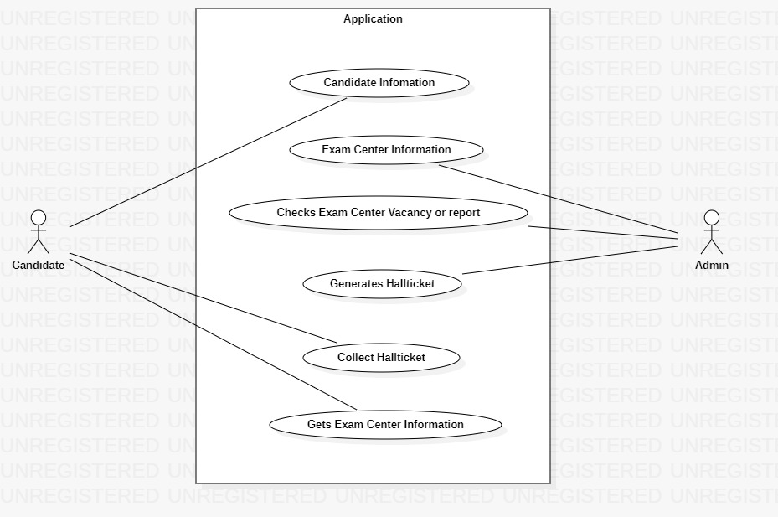
UseCase Diagram:

Slide 12
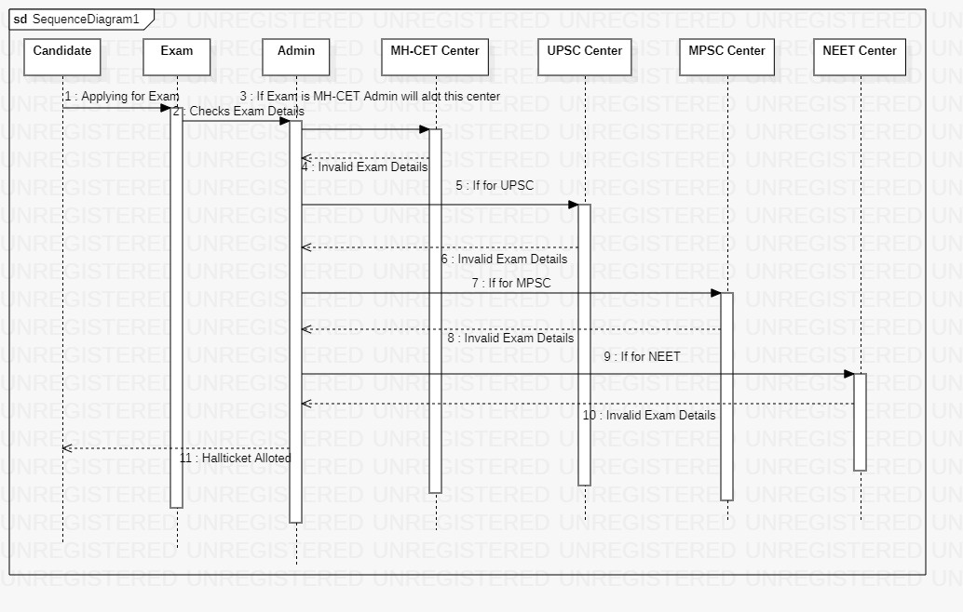
Sequence Diagram:

Slide 13
Conclusion:
In this project we have designed and application which allocates exam centers for respective exams.
We have implemented it using inheritance multithreading and other concepts.
We have used to step compilation process and makefile to built this application.

Slide 14
Thank you

